Slide 1
U.S CONSTITUTION NOTES

Slide 2
I. Articles of Confederation
A. Loosely tied the colonies together to fight the British.
B. Central government had very little power.
Why?

Slide 3
1. Did not allow for an executive- no president or king.

Slide 4
2. It limited the power of congress. a. Congress could not raise taxes or regulate trade.

Slide 5
3. Only powers the national government had were to defend the nation and conduct foreign policy.
*a. But with no money, the Government could not do these well.

Slide 6
4. States printed own money and had trade wars. Inflation was very high. States had territory disputes. a. The National Government had little power to solve problems.

Slide 7
*5. The government could not do what it was supposed to do-
protect the people’s rights.

Slide 8
II. The Constitutional Convention, 1787

Slide 9
Delegates from 12 states meet in Philadelphia to revise the Articles of Confederation.

Slide 10
The #1 goal was to keep the states together as 1 country- The USA. To do this, they felt they needed 2 things…
1. A stronger Central government. A stronger Central Government would be powerful enough and provide enough to keep the states together.
2. A Constitution- a written set of laws that establish a Government the Government must follow.
a. A written set of laws would make sure the central Government followed the rules of the people and couldn’t be changed.

Slide 11
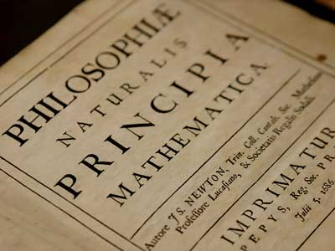
III. Influences
A. The Roman Republic.
B. The Enlightenment- European movement toward logic and reason.

Slide 12
1. Republican Government
- People elect representatives to govern for them.

Slide 13
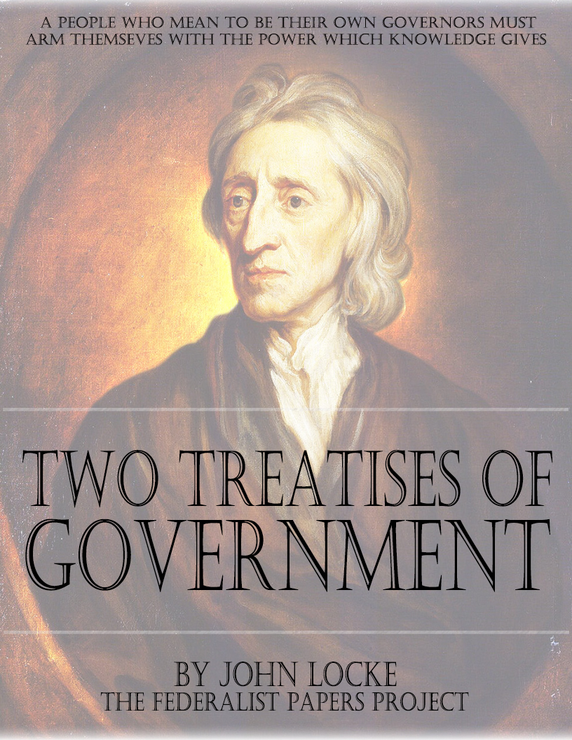
III. Influences
2. John Locke- Natural Rights and Social Contract.

Slide 14
III. Influences
3. Montesquieu- Separation of Powers (SOP) so no one person or group can get too powerful.
a. 3 branches of gov’t with clearly defined powers and limits.
b. Checks and balances- balance the power between the branches, and have checks- powers over each other.

